Slide 1
Socket API – UDP & TCP
NIO
SSL

Slide 2
Overview
Background.
Socket & Socket Types:
  Datagram sockets (UDP).
    Connectionless.
    Connection-oriented.
  Stream sockets (TCP).
Sockets with Non-blocking Operations.
Secure Socket API.

Slide 3
Background
Socket API appeared in early 80’s as a program library in Berkeley UNIX to provide the functionalities for IPC.
Today supported on all major OS:
  UNIX based (including Linux) part of the OS.
  MS-DOS, NT (and variants), Mac-OS, OS/2 – API provided as program libraries; Winsock on Windows.
Java provides the socket API as part of the language's core classes.
API’s all share the same message passing model and have similar syntax. (e.g. WinSock: http://msdn.microsoft.com/en-us/library/aa925696.aspx)

Slide 4
Socket and Socket API - 1
Term socket is borrowed from telephone communications.
Socket API provides a mechanism that provides a low-level of abstraction for IPC.
Understanding required for two reasons:
  Upper layer facilities built on top of the socket API.
  Appropriate design solution – response time, limited resources.
Socket API provides a programming construct termed a socket.

Slide 5
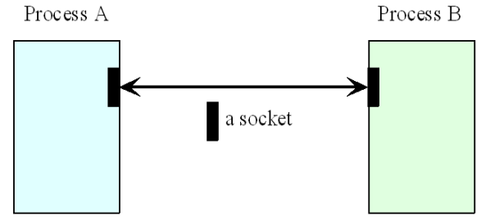
Socket and Socket API - 2
Process wishing to communicate with another process must create an instance of a socket.

Slide 6
Socket Types
Communication between the processes can be:
  Connection-oriented – using TCP.
  Connectionless – using UDP.
Java socket API provides socket programming constructs that make use of either the UDP or the TCP protocol.
Sockets that use UDP for transport – datagram sockets.
Sockets that use TCP for transport – stream sockets.

Slide 7
Datagram Sockets - 1
This type of socket can support both connectionless and connection-oriented communications at the application layer.
Even though datagrams are sent or received without the notion of connections at the transport layer, the runtime support of the socket API can create and maintain logical connections for datagrams exchanged between two processes.
Connectionless datagrams are the most typically used.

Slide 8
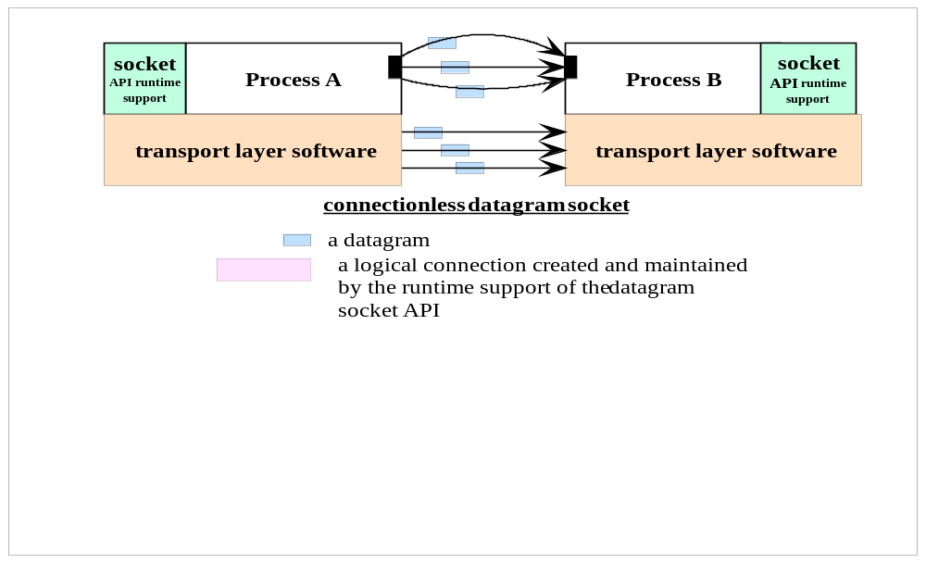
Datagram Sockets - 2

Slide 9
Datagram Sockets - 3
In Java, two classes are provided for the datagram socket API:
  DatagramSocket class for the sockets.
  DatagramPacket class for the datagram exchanged.
A process wishing to send or receive data using this API must instantiate a DatagramSocket object, or a socket in short.
Each socket is said to be bound to a UDP port of the machine local to the process.

Slide 10
Sending a Datagram
To send a datagram to another process, a process:
  Creates an object that represents the datagram itself.
  This object can be created by instantiating a DatagramPacket object which carries
    The payload data as a reference to a byte array.
    The destination address (the host ID and port number to which the receiver’s socket is bound.
Sending process issues a call to a send() method in the DatagramSocket object, specifying a reference to the DatagramPacket object as an argument.

Slide 11
Receiving a Datagram
DatagramSocket object must also be instantiated and bound to a local port.
Port number must agree with that specified in the datagram packet of the sender.
To receive datagrams sent to the socket, the process creates a DatagramPacket object which references a byte array and calls a receive() method in its DatagramSocket object, specifying as argument a reference to the DatagramPacket object.

Slide 12
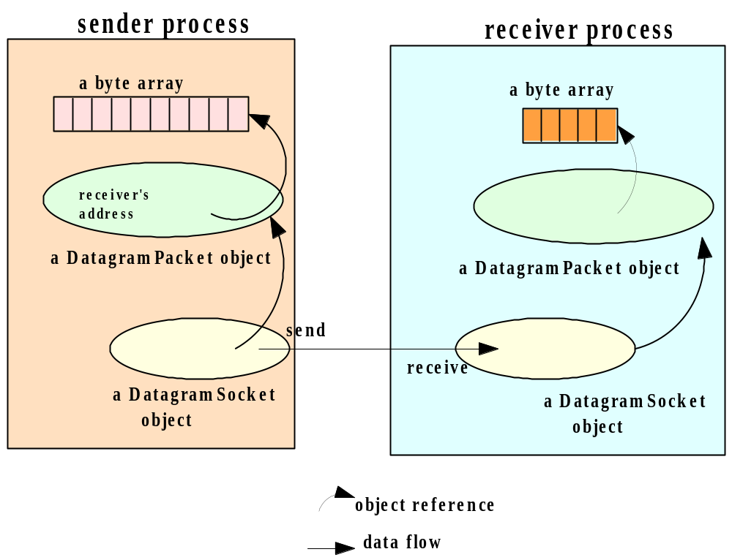
Data Structures - Sender and Receiver Programs

Slide 13
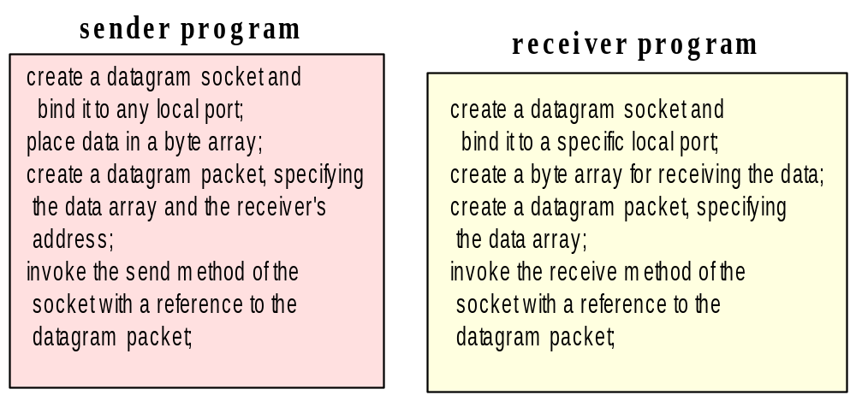
Program Flow - Sender & Receiver Programs

Slide 14
Datagram Sockets - 4
With connectionless sockets a socket bound to a process can be used to send datagrams to different destinations.
Possible for multiple processes to simultaneously send datagrams to the same socket bound to a receiving process.
The order of arrival is unpredictable. Issues?

Slide 15
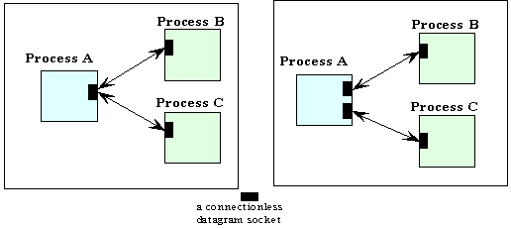
Datagram Sockets - 5
Figure 4.5a – Process A uses single socket to communicate with 2 processes.
Figure 4.5b – Separate socket opened for each connecting process.
Figure 4.5 (a)
Figure 4.5 (b)

Slide 16
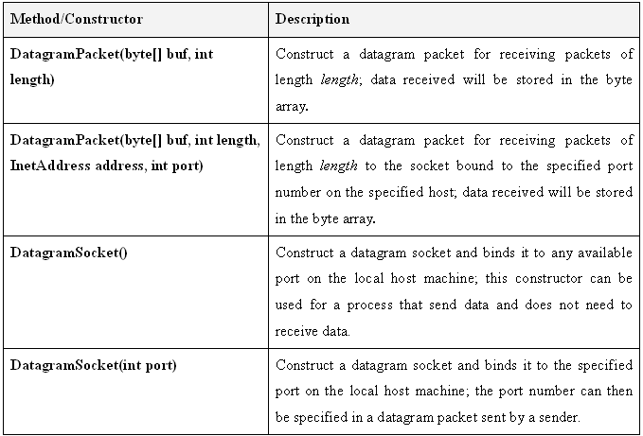
Datagram - Class and Methods - 1

Slide 17
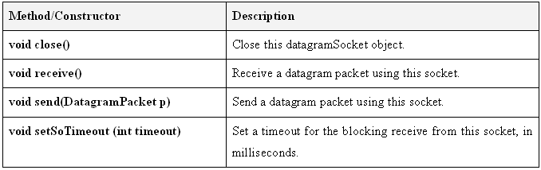
Datagram - Class and Methods - 2

Slide 18
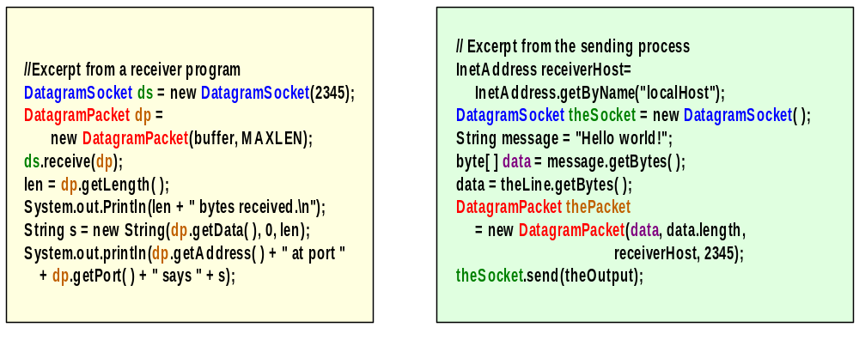
Source – Connectionless Datagram
Receiver
Sender

Slide 19
Event Synchronization - Datagram Sockets - 1
Send operations are non-blocking.
Receive operations are blocking.
Process continues with its execution after the send() method is called.
Process is suspended with the receive() method is called.
Can use the setSoTimeout() to avoid indefinite blocking – with a time interval.

Slide 20
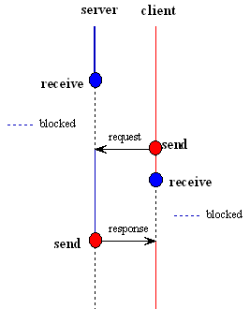
Event Synchronization Datagram Sockets - 2
Diagram illustrates blocking receive and non-blocking send in a Request-Response protocol.
If sent is sent before the receive is in receive mode the data will be lost.

Slide 21
Code Samples
Simplex communication – one-way:
  Example1Sender.java.
  Example1Receiver.java.
Duplex/bidirectional – two-way:
  MyDatagramSocket.java.
  Example2SenderReceiver.java.
  Example2ReceiverSender.java.
Exercise: run all these examples in the next lab session

Slide 22
Advantages of Datagram Socket
More Efficient – Given an application where packet size is small and frequent guaranteed overhead may not be required.
Reduced Overhead – In centralised system with single server overhead of multiple TCP socket connections may be an issue. Maximum number of threads on Windows/Unix?
Reduced Delay – With UDP there are fewer delays due to error checking and flow control.

Slide 23
Disadvantages of Datagram Socket
No Guaranteed Packet Delivery – Packets sent via UDP may be lost. If a file is being transferred a loss in packet data is unacceptable.
No Packet Sequencing – Packet sequencing must be included for those applications that require sequential data access. No default sequence number as in TCP (see Slide 46).
No Flow Control – Flow control shapes Internet traffic to prevent the network from overload. We may limit the rate of packets sent per second or the number of packets that are unacknowledged.

Slide 24
Stream Sockets - 1
The datagram socket API supports the exchange of discrete units of data (that is, datagrams).
The stream socket API provides a model of data transfer based on the stream-mode I/O of the Unix operating systems.
By definition, a stream-mode socket supports connection-oriented communication only.

Slide 25
Stream Mode I/O - 1
In stream mode I/O data is transferred using the concept of a continuous data stream flowing from a source to a destination – a sink.
Data is inserted/written into a stream by a process that controls the source.
Data is extracted/read from the stream by process attached to destination
Data can be inserted & extracted at different rates – due to continuous nature of stream.

Slide 26
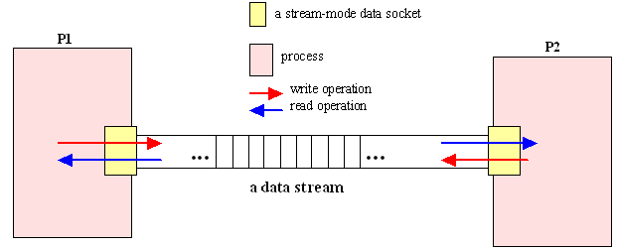
Stream Mode I/O - 2

Slide 27
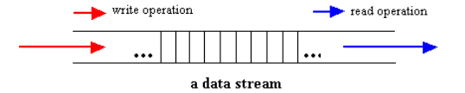
Stream Mode I/O - 3
Units of data written and read do not need to match e.g. 100 bytes can be written with one write() operation and read by 5 read() operations, each containing 20 bytes.

Slide 28
Stream-Mode Socket - 1
Stream-mode socket API – extension of stream-mode I/O model.
Each of two processes individually creates a stream-mode socket.
Connection formed.
Data – stream of chars is written to sender’s socket.
Read by the receiver via its socket.
Similar to connection-oriented datagram – datagram discrete packets.

Slide 29
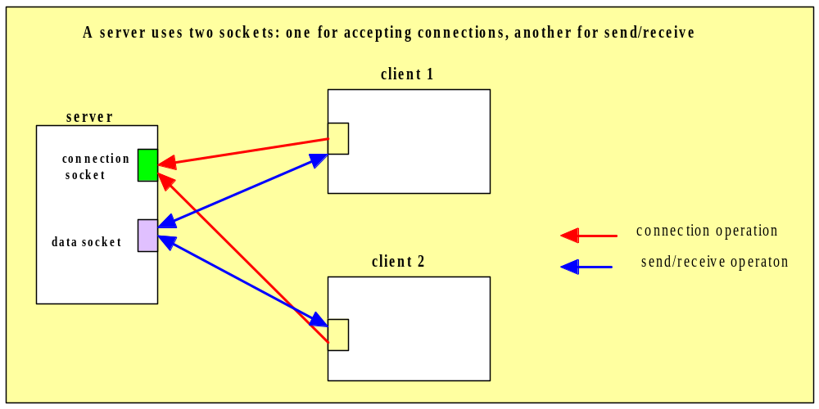
Stream-Mode Socket - 2

Slide 30
The Server
Using this API, a process called a server establishes a connection socket and then listens for connection requests from other client processes.
Connection requests accepted one at a time.
When a connection is accepted a data socket is created for connection.
Socket – server process can read from and/or write to data stream.
Session over – data socket closed – server can receive another connection request via connection socket.

Slide 31
The Client
Process that communicates with the server – a client.
Client creates a socket and makes a request to the server for a connection – via the server’s connection socket.
Once request is accepted – client’s socket connected to server’s data socket.
Client proceeds to read/write to data stream.
Session is complete – data socket is closed.

Slide 32
Classes and Methods
In Java, the stream-mode socket API is provided with two classes:
  ServerSocket: for accepting connections; we will call an object of this class a connection socket.
  Socket: for data exchange; we will call an object of this class a data socket.

Slide 33
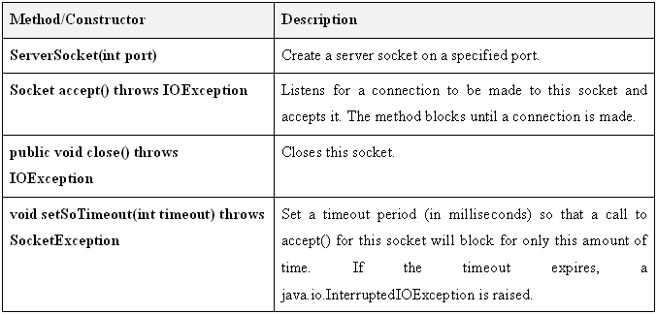
ServerSocket - Class and Methods

Slide 34
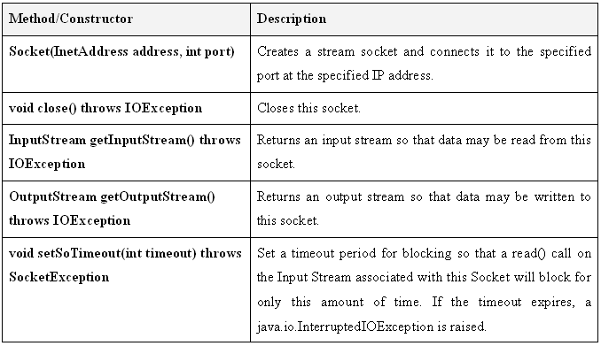
Socket - Classes and Methods
Note: No read()/write() methods – use methods associated with InputStream and OutputStream classes.

Slide 35
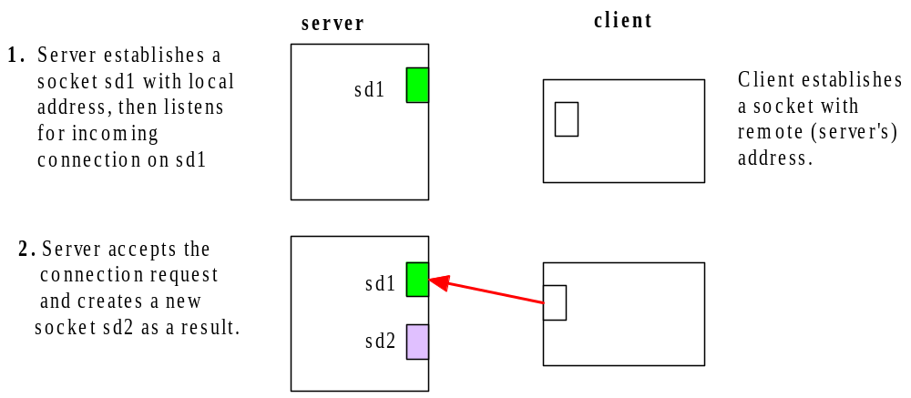
Connection-Oriented Socket

Slide 36
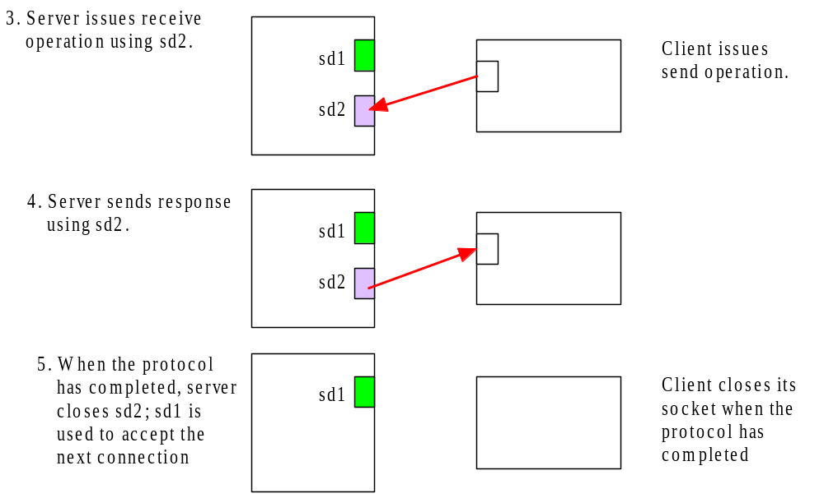
Connection-oriented Socket

Slide 37
Event Synchronization
The following operations are blocking:
  Accept() – If no request is waiting – server process will be suspended until a request for connection arrives.
  Read from input stream of a socket – if the amount of data requested is NOT in data stream – reading process is blocked until a sufficient amount of data has been written into the data stream
Write operation to stream operation is non-blocking.

Slide 38
Program Flow
connection listener (server)
connection requester (client)
create a connection socket
create a data socket
and listen for connection
and request for a connection;
requests;
accept a connection;
get an output stream for writing
creates a data socket for reading from
to the socket;
or writing to the socket stream;
write to the stream;
get an input stream for reading
to the socket;
get an input stream for reading
read from the stream;
to the socket;
get an output stream for writing
read from the stream;
to the socket;
close the data socket.
write to the stream;
close the data socket;
close the connection socket.

Slide 39
Code Samples
Basic stream-mode sockets:
  Example4ConnectionAcceptor.java. (Server)
  Example4ConnectionRequestor.java. (Client)
Basic stream-mode sockets – separation of application logic & service logic:
  Example5ConnectionAcceptor.java.
  Example5ConnectionRequestor.java.
  MyStreamSocket.java
Exercise: run the codes in the next lab session

Slide 40
Advantages of Stream Sockets
Automatic Error Control - TCP packets includes checksum as in UDP but lost data packets are retransmitted. Guaranteed delivery is achieved using a timed acknowledgement protocol.
Reliability - Each packet contains sequence number. Late packets are queued and packet re-ordering is applied.
Ease Of Use – Conceptually more straightforward than UDP since data transfer is in a continuous stream and not discrete units.

Slide 41
Disadvantages of Stream Sockets
Network Overhead –Increase in network traffic as a result of presence of Acknowledgement packets.
Sender-side Overhead - Sender is required to maintain timer for unacknowledged packets (may require a thread for each client connection).
Receiver-side Overhead – Receiver is required to potentially buffer and re-order out-of-sequence packets.

Slide 42
Sockets-Non-blocking I/O Operations
Socket API provides non-blocking send operations and blocking receive operations.
Process that reads from a socket is subject to blocking.
Alternatives:
  Use threads to max concurrency – overhead too large
  Use non-blocking socket API.

Slide 43
Sockets-Non-blocking I/O Operations
Send and receive operations are non-blocking.
Examples:
  Winsock.
  Java non blocking sockets (NIO.2) Syntax more complex than blocking socket API.
    Stream v Buffer oriented
    Blocking v non-blocking
    Selectors
    The API

Slide 44
NIO is Buffer Oriented
Stream Oriented vs. Buffer Oriented
The first big difference between Java NIO and IO is that IO is stream oriented, where NIO is buffer oriented. So, what does that mean?
Java IO being stream oriented means that you read one or more bytes at a time, from a stream. What you do with the read bytes is up to you. They are not cached anywhere. Furthermore, you cannot move forth and back in the data in a stream. If you need to move forth and back in the data read from a stream, you will need to cache it in a buffer first.
Java NIO's buffer oriented approach is slightly different. Data is read into a buffer from which it is later processed. You can move forth and back in the buffer as you need to. This gives you a bit more flexibility during processing. However, you also need to check if the buffer contains all the data you need in order to fully process it. And, you need to make sure that when reading more data into the buffer, you do not overwrite data in the buffer you have not yet processed.

Slide 45
NIO is Non-Blocking
Blocking vs. Non-blocking IO
Java IO's various streams are blocking. That means, that when a thread invokes a read() or write(), that thread is blocked until there is some data to read, or the data is fully written. The thread can do nothing else in the meantime.
Java NIO's non-blocking mode enables a thread to request reading data from a channel, and only get what is currently available, or nothing at all, if no data is currently available. Rather than remain blocked until data becomes available for reading, the thread can go on with something else.
The same is true for non-blocking writing. A thread can request that some data be written to a channel, but not wait for it to be fully written. The thread can then go on and do something else in the mean time.
What threads spend their idle time on when not blocked in IO calls, is usually performing IO on other channels in the meantime. That is, a single thread can now manage multiple channels of input and output.
http://tutorials.jenkov.com/java-nio/nio-vs-io.html

Slide 46
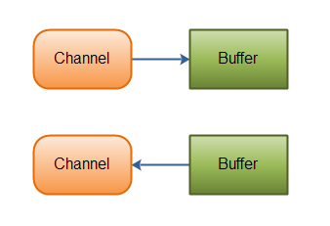
NIO Channels
Java NIO Channels are similar to streams with a few differences:
You can both read and write to a Channels. Streams are typically one-way (read or write).
Channels can be read and written asynchronously.
Channels always read to, or write from, a Buffer.

Slide 47
NIO Channels
Here are the most important Channel implementations in Java NIO:
  FileChannel
  DatagramChannel
  SocketChannel
  ServerSocketChannel

Slide 48
NIO Selectors
Java NIO's selectors allow a single thread to monitor multiple channels of input.
You can register multiple channels with a selector, then use a single thread to "select" the channels that have input available for processing, or select the channels that are ready for writing.
This selector mechanism makes it easy for a single thread to manage multiple channels.

Slide 49
The API Calls
Of course the API calls when using NIO look different than when using IO.
Rather than just read the data byte for byte from e.g. an InputStream, the data must first be read into a buffer, and then be processed from there.

Slide 50
Here is a simplified example using NIO
ByteBuffer buffer = ByteBuffer.allocate(48); int
bytesRead = inChannel.read(buffer);
Notice the second line which reads bytes from the channel into the ByteBuffer.
When that method call returns you don't know if all the data you need is inside the buffer.
All you know is that the buffer contains some bytes. This makes processing somewhat harder.

Slide 51
NIO Example
Imagine if, after the first read(buffer) call, that all what was read into the buffer was half a line.
For instance, "Name: An". Can you process that data? Not really.
You need to wait until at least a full line of data has been into the buffer, before it makes sense to process any of the data at all.
So how do you know if the buffer contains enough data for it to make sense to be processed? Well, you don't.

Slide 52
NIO Example
The only way to find out, is to look at the data in the buffer.
The result is, that you may have to inspect the data in the buffer several times before you know if all the data is in there.
This is both inefficient, and can become messy in terms of program design. For instance:
ByteBuffer buffer = ByteBuffer.allocate(48);
int bytesRead = inChannel.read(buffer);
while(! bufferFull(bytesRead) )
{ bytesRead = inChannel.read(buffer); }

Slide 53
IO v NIO
NIO allows you to manage multiple channels (network connections or files) using only a single (or few) threads, but the cost is that parsing the data might be somewhat more complicated than when reading data from a blocking stream.
If you need to manage thousands of open connections simultanously, which each only send a little data, for instance a chat server, implementing the server in NIO is probably an advantage.
Similarly, if you need to keep a lot of open connections to other computers, e.g. in a P2P network, using a single thread to manage all of your outbound connections might be an advantage.
This one thread, multiple connections design is illustrated in this diagram:

Slide 54
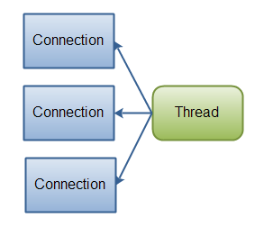
IO v NIO

Slide 55
IO v NIO
If you have fewer connections with very high bandwidth, sending a lot of data at a time, perhaps a classic IO server implementation might be the best fit.
The next diagram illustrates a classic IO server design:
(See NIO v Node.JS)
https://docs.oracle.com/javase/8/docs/technotes/guides/io/index.html

Slide 56
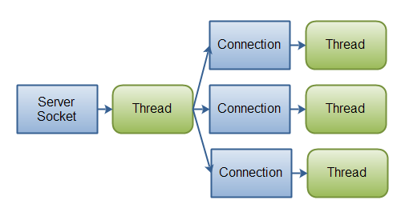
IO v NIO

Slide 57
Programming NIO
With all these complications programming Java NIO is much more difficult than programming Java IO

Slide 58
Secure Socket API - 1
The Socket API with data security measures.
Allows you to transmit data over a socket securely.
Otherwise the bit streams sent can be intercepted using network tools – n/w protocol analysers, etc.
Examples:
  Secure Socket Layer (SSL)
  Java Secure Socket Extension (JSSE).

Slide 59
SSL
Secure Sockets Layer (SSL) is a standard security technology for establishing an encrypted link between a server and a client—typically a web server
SSL allows sensitive information such as credit card numbers, social security numbers, and login credentials to be transmitted securely.
Normally, data sent between browsers and web servers is sent in plain text—leaving you vulnerable to eavesdropping. If an attacker is able to intercept all data being sent between a browser and a web server, they can see and use that information.
More specifically, SSL is a security protocol. Protocols describe how algorithms should be used. In this case, the SSL protocol determines variables of the encryption for both the link and the data being transmitted.

Slide 60
SSL
All browsers have the capability to interact with secured web servers using the SSL protocol.
However, the browser and the server need what is called an SSL Certificate to be able to establish a secure connection.
SSL secures millions of peoples’ data on the Internet every day, especially during online transactions or when transmitting confidential information.
Internet users have come to associate their online security with the lock icon that comes with an SSL-secured website or green address bar that comes with an Extended Validation SSL-secured website.
SSL-secured websites also begin with https rather than http.

Slide 61
SSL and TLS Versions
Over the years the protocol has been made more secure and faster.
SSL 1.0 (Never used) Netscape - proprietary
SSL 2.0 1995 (flaws - insecure) Netscape
SSL 3.0 1996 (insecure) Netscape
TLS 1.0 1999 (legacy) IETF standard
TLS 1.1 2006 (legacy) IETF standard
TLS 1.2 2008 (secure) IETF standard
TLS 1.3 2017 IETF standard (https://tools.ietf.org/html/rfc8446)

Slide 62
SSL and TLS
These different versions are all in widespread use today in applications such as web browsing, e-mail, instant messaging and VoIP, and each is slightly different from the others.
Check your SSL: https://www.howsmyssl.com/
Check your server: https://www.sslshopper.com/ssl-checker.html and https://www.ssllabs.com/ssltest/

Slide 63
SSL/TLS Handshake
Handshake(Short) https://www.youtube.com/watch?v=4nGrOpo0Cuc
Handshake (Long)
  https://www.youtube.com/watch?v=ubHZQrECeew
Handshake (with Wireshark)
  https://www.youtube.com/watch?v=u4ht-E-Kihk

Slide 64
JSSE and TLS
- The JavaTM Secure Socket Extension (JSSE) is a Java package that enables secure Internet communications.
It implements a Java version of SSL (Secure Sockets Layer) and TLS (Transport Layer Security) protocols
It includes functionalities for data encryption, server authentication, message integrity, and optional client authentication.
Using JSSE, developers can provide for the secure passage of data between a client and a server running any application protocol
https://www.baeldung.com/java-ssl
An alternative package is to use OpenSSL (https://www.openssl.org/)
Other TLS implementations: https://en.wikipedia.org/wiki/Comparison_of_TLS_implementations

Slide 65
The Java Secure Socket Extension API http://java.sun.com/products/jsse/doc/apidoc/index.html
Import javax.net.ssl;
Class SSLServerSocket is a subclass of ServerSocket, and inherits all its methods.
Class SSLSocket is a subclass of Socket, and inherits all its methods.
There are also classes for
  Certification
  Handshaking
  KeyManager
  SSLsession
Writing a Java SSL Client
  https://www.youtube.com/watch?v=S2Vxr3RoRgI
Writing Java code using SSL/TLS
  http://www.ateam-oracle.com/tls-and-java/
TrustStore
  https://javarevisited.blogspot.com/2012/09/difference-between-truststore-vs-keyStore-Java-SSL.html
  http://www.java67.com/2012/12/difference-between-truststore-vs.html

Slide 66
Review
Background.
Socket & Socket Types:
  Datagram sockets (UDP).
    Connectionless.
    Connection-oriented.
  Stream sockets (TCP).
Sockets with Non-blocking Operations.
Secure Socket API.

Slide 67
Additional Reading Resources
Java Network Programming & Distributed Computing, by David Reilly & Michael Reilly
(see http://safari.oreilly.com bookshelf)

